Slide 1
IKPy
An Inverse Kinematics toolbox

Slide 2
Outline
An inverse kinematics toolbox
IKPy functionnalities
Using IKPy
Live Demo

Slide 3
Inverse Kinematics

Slide 4
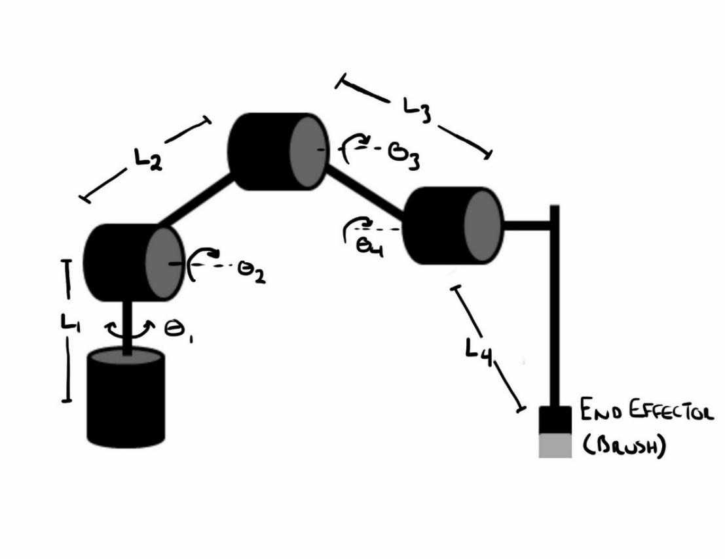
Inverse Kinematics (IK)
What you have : A robot where you can choose each motor’s angle
What you want to do : move the end effector to this position
How to do it : Find a combination of motor angles

Slide 5
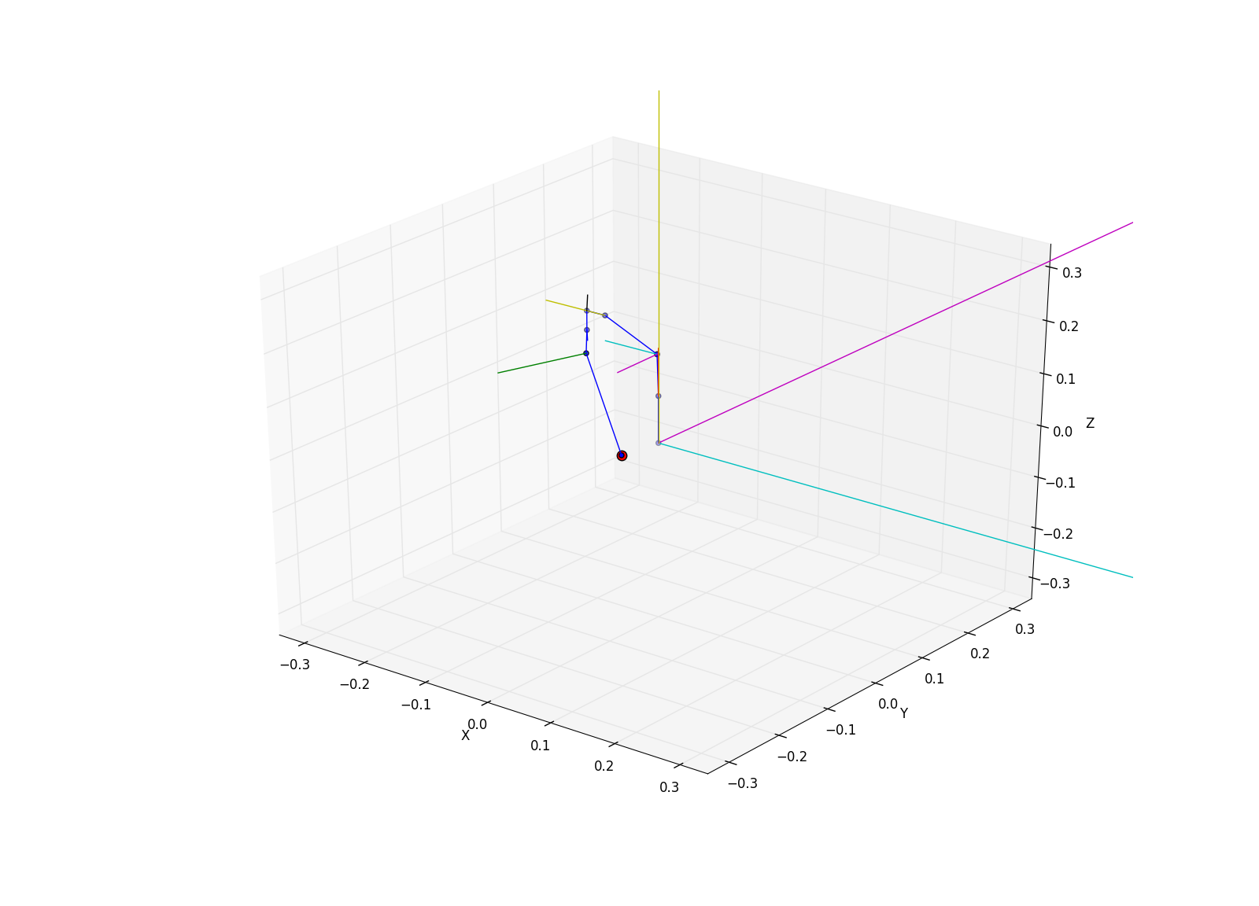
Desired functionnalities
Compatibility :
Poppy Humanoid, Torso,
Baxter
Human
Everything else…
Modularity
Plotting tools
Easy to use and setup
Fast enough

Slide 6
IKPy at a glance

Slide 7


Optimized computations
Almost based on C structures
Fast Forward-Kinematics
Symbolic geometrical computations
Possibility to control the computation precision
Tradeoff between precision and speed
Average computation time : 7 ms – 50 ms
Special optimisations :
Multicore? (Work in progress)
Dynamic IK

Slide 8
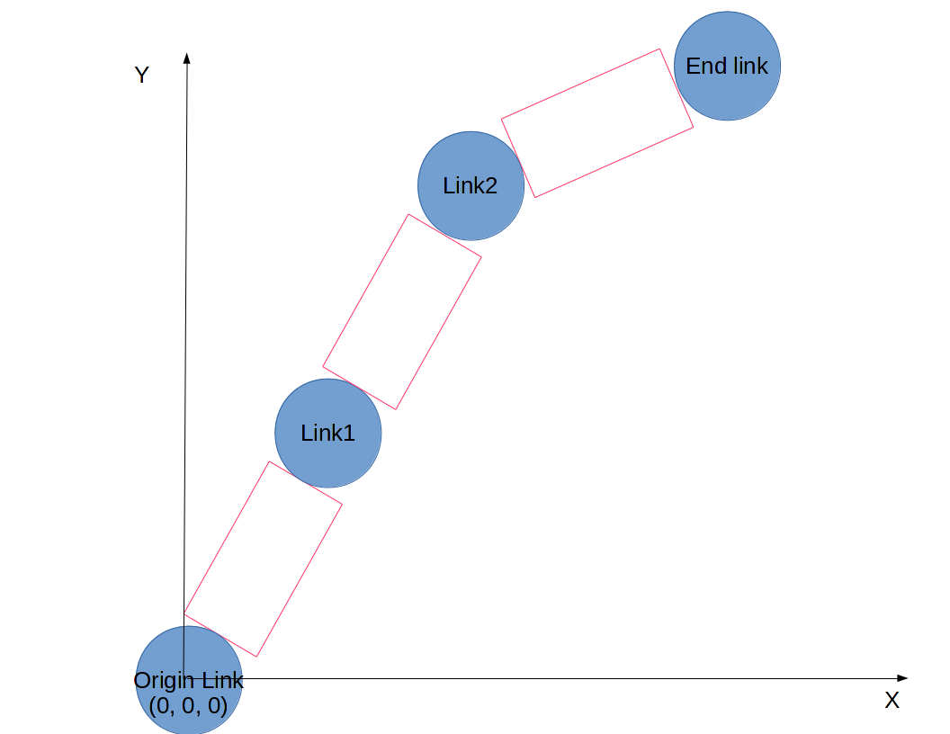
Simple API
2 objects :
Link ~= A motor
Chain = Ordered list of Links

Slide 9
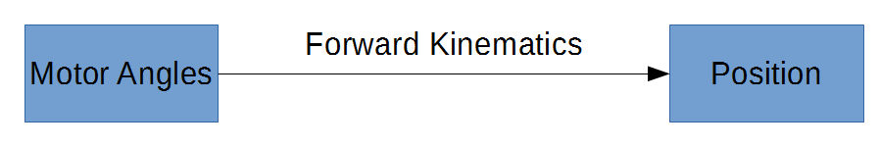
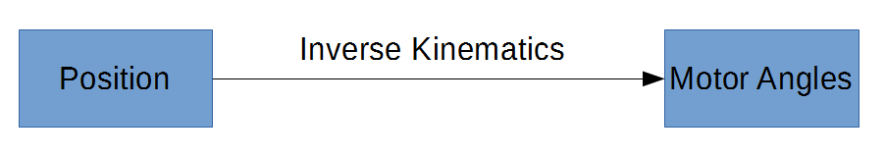
Simple API (2)
2 functions :
Chain.forward_kinematics
Chain.inverse_kinematics
Additional features :
Active links
Smoothness control (very related to precision control)

Slide 10
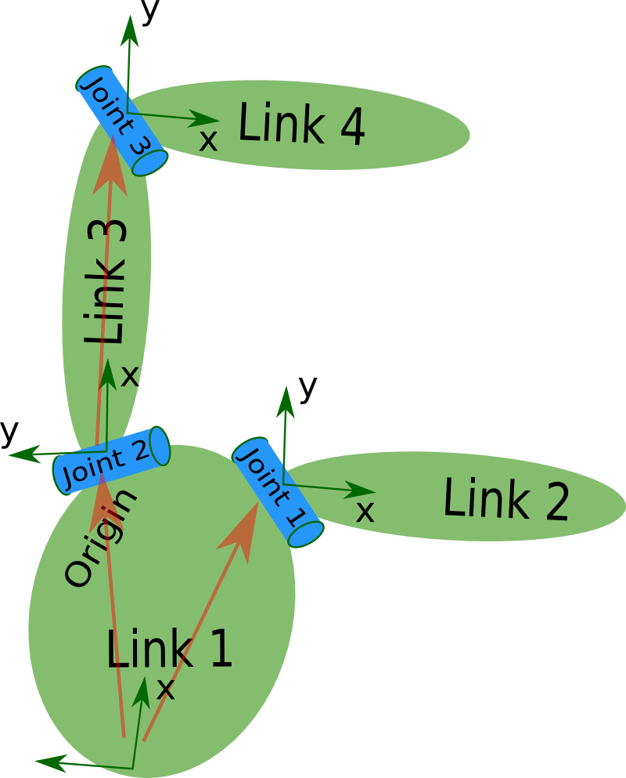
URDF Import
URDF : XML describing a Robot (as graph)
Used by ROS, Poppy
Compatible with 3D editors
Extract a chain from every URDF topology
Extreme precision : No limitation at the Software level

Slide 11
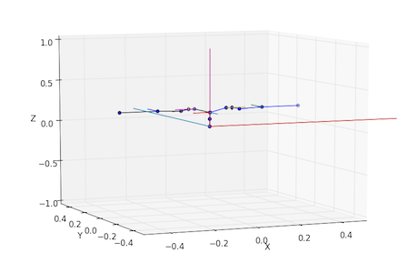
3D Plotting of the robot
Method plot() : Matplotlib 3D view
Standalone use

Slide 12
Using IKPy

Slide 13

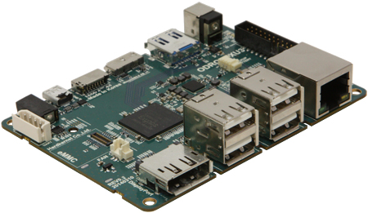
A lightweight library
Easy to install : Pip or Conda
No compilation required
Compatibility with most systems :
Python 2/3
Dependencies : Scipy / Numpy, Sympy
Fast enough for Embedded systems

Slide 14
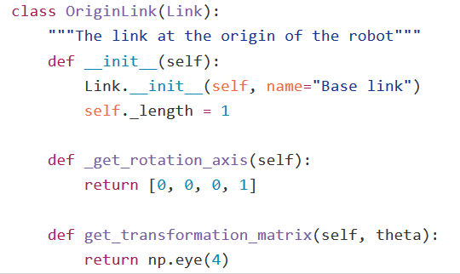
Developer API
API to customize IKPy behavior :
New representations
URDF
DH parameters
New Inverse Kinematics methods
New constraints : effort, speed
New solvers

Slide 15

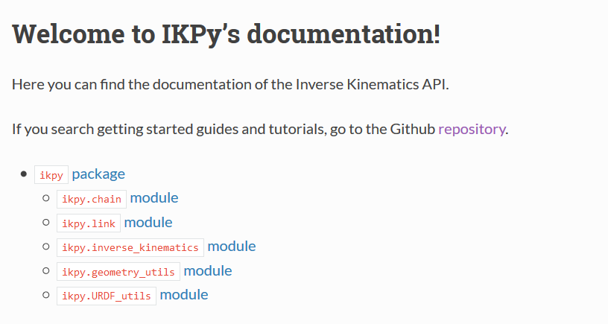
Last features (1)
Open source
Online documentation

Slide 16
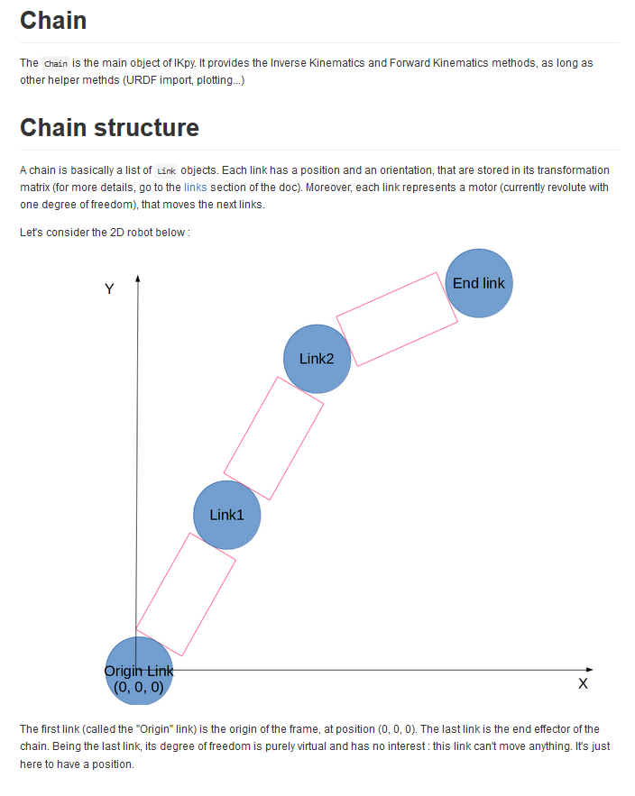
Last features (2)
Tutorials and notebooks

Slide 17
Example : Pypot Integration
Fully integrated with Pypot
Chains = attributes of creatures
Ex of Torso : torso.right_arm / torso.left_arm
IK = goto() method

Slide 18
Demo

Slide 19
Live Demo
Poppy torso : right hand must follow left hand.
IKPy features : Demo on ErgoJr.

